Slide 1
MODULE 6
Code Optimization:
Principal sources of optimization, Optimization of Basic blocks
Code generation:
Issues in the design of a code generator. The target machine, A simple code generator.
Notes:
lec07-intermediatecg
January 4, 1980

Slide 2
COURSE OUTCOME
Apply optimization techniques to intermediate code and generate machine code for high level language program.
Notes:
lec07-intermediatecg
January 4, 1980

Slide 3
CODE OPTIMIZATION
Notes:
lec07-intermediatecg
January 4, 1980

Slide 4
Code optimization:
  A transformation to a program to make it run faster and/or take up less space.
  Optimization should be safe, preserve the meaning of a program.
  Code optimization is an important component in compiler.
Notes:
lec07-intermediatecg
January 4, 1980

Slide 5
Optimizations within a basic block is called local optimization.
Optimizations across basic blocks is called global optimization.
Some common optimizations:
  Function -Preserving Transformations
    Common subexpression elimination
    Copy Propagation
    Dead code elimination
    Constant folding
  Loop Optimizations
    Code Motion
    Induction Variable eliminations
    Reduction in Strength
Notes:
lec07-intermediatecg
January 4, 1980

Slide 6
BASIC BLOCKS and FLOW GRAPHS
Basic Blocks
Sequence of consecutive statements in which flow of control enters at the beginning and leaves at the end without halt.
Flow Graphs
We can add the flow of control information to the set of basic blocks. This is represented with a directed graph. This directed graph is called FLOW GRAPH.
The nodes of the flow graph are the basic blocks.
One node is distinguished as initial
There is a directed edge from block B1 to Block B2 if B2 can immediately follow B1 in some execution sequence.
Notes:
lec07-intermediatecg
January 4, 1980

Slide 7
BASIC BLOCKS and FLOW GRAPHS
Algorithm to partition a sequence of three address code into basic block
Input : A sequence of three address code
Output : A list of Basic Blocks
Method :
1. First determine the set of leaders.
i) The first statement is a leader
ii) Any statement that is the target of a conditional or unconditional statement is a leader
Iii) Any statement that immediately follows a goto or conditional goto statement is a leader
2. For each leader, its basic block consists of the leader and all statements up to the next leader or the end of the program
Notes:
lec07-intermediatecg
January 4, 1980

Slide 8
Here it contains two basic blocks 1&2 is a block and 3 to 7 is another block
{
p = 0;
i = 1;
do
{
p = p + a;
i = i + 1;
}while(i<=10)
}
(1) p = 0
(2) i = 1
(3) t1 = p+a
(4) p=t1
(5) t2 = i + 1
(6) i = t2
(7) if i<=10 goto (3)
Notes:
lec07-intermediatecg
January 4, 1980

Slide 9
Another Example
i=m-1;
j=n;
v=a[n];
While(1)
{
do i=i+1; while (a[i] < v);
do i=j-1; while (a[j]>v);
if(i>=j) break;
x=a[i]; a[i]=a[j]; a[j]=x;
}
x=a[i]; a[i] = a[n]; a[n] = x;
Notes:
lec07-intermediatecg
January 4, 1980

Slide 10
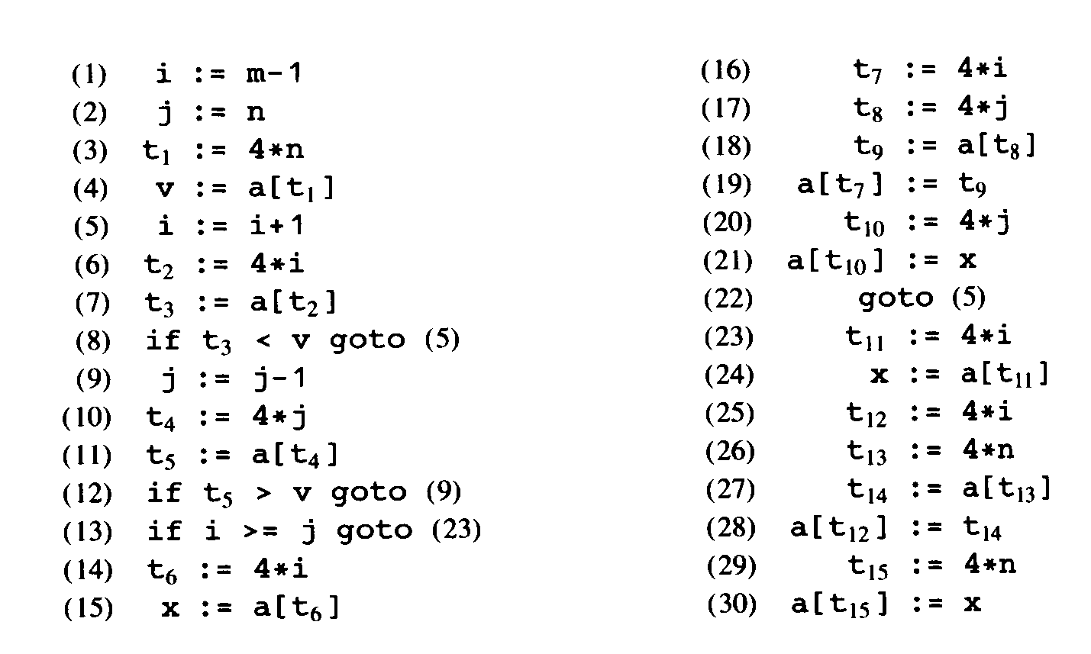
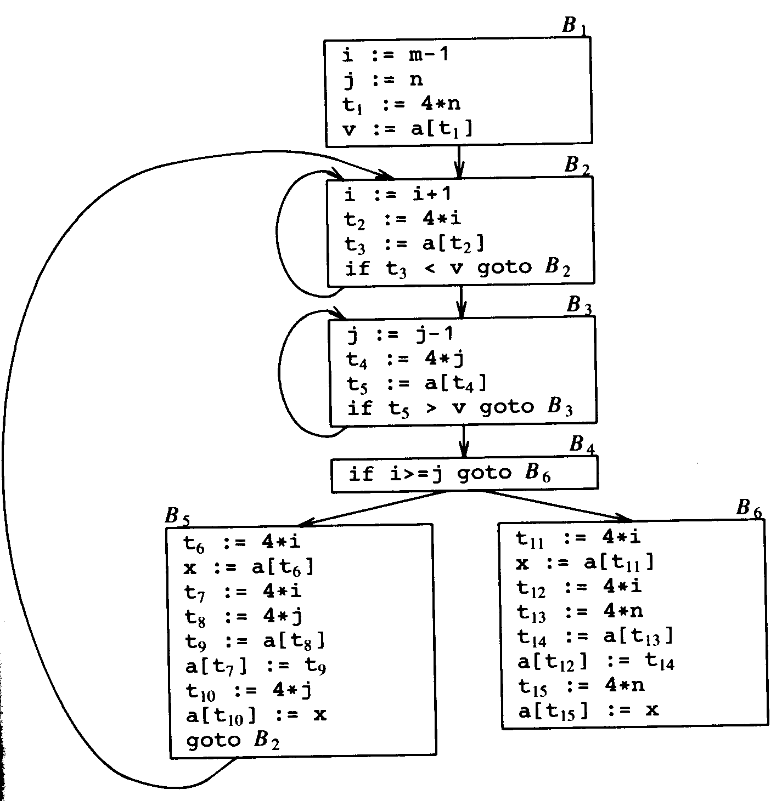
Three address code and CFG
Notes:
lec07-intermediatecg
January 4, 1980

Slide 11
Function-Preserving Transformations
Common Subexpression elimination.
Copy propagation.
Dead-code elimination.
Constant folding.
Notes:
lec07-intermediatecg
January 4, 1980

Slide 12
Common Subexpressions Elimination
An occurrence of an expression E is called a common subexpression if E was previously computed, and the values of variables in E have not changed since the previous computation.
In block B5 expressions 4*i and 4*j are occurring twice. After common subexpression elimination B5 will change to
t6=4*i
x=a[t6]
t8=4*j
t9=a[t8]
a[t6]=t9
a[t8]=x
Goto B2
Notes:
lec07-intermediatecg
January 4, 1980

Slide 13
Common Subexpressions Elimination
Function preserving transformations can be done both locally and globally.
When do globally t6=4*i and x=a[t6] in B5 can be replaced with x = t3 and so on.
So after global optimization B5 will be
x := t3
a[t2] := t5
a[t4] := x
goto B2
Notes:
lec07-intermediatecg
January 4, 1980

Slide 14
Copy Propagation
Identifies variables that have constant/copy values and uses the constants/copies in place of the variables.
f := g are called copy statements or copies
Use of g for f, whenever possible after copy statement
  Example:
  before : x[i] = a; after : x[i] = a;
  sum = x[i] + a; sum = a + a;
Block B5 : x := t3
a[t2] := t5
a[t4] := t3
goto B2
May not appear to be code improvement, but opens up scope for other optimizations.
Notes:
lec07-intermediatecg
January 4, 1980

Slide 15
Dead Code Elimination
Dead Code are portion of the program which will not be executed in any path of the program.
  Can be removed
Examples:
  No control flows into a basic block
  A variable is dead at a point -> its value is not used anywhere in the program
  An assignment is dead -> assignment assigns a value to a dead variable
In block B5, x := t3 can be removed.
Notes:
lec07-intermediatecg
January 4, 1980

Slide 16
Loop optimizations
Code Motion
Induction Variables elimination
Reduction in Strength
Notes:
lec07-intermediatecg
January 4, 1980

Slide 17
Code Motion
Decreases the amount of code in a loop.
Takes an expression that yields the same result independent of the number of times a loop is executed and places the expression before the loop.
Example : while( i <= limit – 2) is a looping statement and if limit is not changing within the loop, then every time limit-2 need to be calculated for the comparison. So this can be replaced as
t = limit-2;
while(i<t)
Notes:
lec07-intermediatecg
January 4, 1980

Slide 18
Induction Variables elimination
In block B2 i and t2 are induction variables because when the value of i is incremented by 1 value of t2 is incremented by 4 . (t2 = 4*i)
Notes:
lec07-intermediatecg
January 4, 1980

Slide 19
Peephole optimization:
    Redundant instruction elimination
    Flow of control optimization
    Algebraic simplifications
    Instruction selection
    Examples:
      Redundant loads and stores
        MOV R0, a
        MOV a, R0
      Unreachable code
        If debug = 1 goto L1
        Goto L2
        L1: print debugging info
        L2:
Notes:
lec07-intermediatecg
January 4, 1980

Slide 20
  Examples:
    Flow of control optimization:
goto L1
…
L1: goto L2
goto L2
…
L1: goto L2
if a < b goto L1
…
L1: goto L2
if a<b goto L2
…
L1: goto L2
goto L1
…
L1: if a < b goto L2
if a < b goto L2
goto L3
…
L1:
L3:
Notes:
lec07-intermediatecg
January 4, 1980

Slide 21
Algebraic simplification:
  x : = x+0
  x := x*1 ==➔ nop
Reduction in strength
  X^2 → x * x
  X * 4 → x << 2
Instruction selection
  Sometimes some hardware instructions can implement certain operation efficiently.
Notes:
lec07-intermediatecg
January 4, 1980

Slide 22
Code optimization can either be high level or low level:
  High level code optimizations:
    Loop unrolling, loop fusion, procedure inlining
  Low level code optimizations:
    Instruction selection, register allocation
  Some optimization can be done in both levels:
    Common subexpression elimination, strength reduction, etc.
  Flow graph is a common intermediate representation for code optimization.
Notes:
lec07-intermediatecg
January 4, 1980

Slide 23
CODE GENERATION
Notes:
lec07-intermediatecg
January 4, 1980

Slide 24

Outline
Generation Issues
Target language Issues
Addresses in Target Code
A Simple Code Generator
Notes:
lec07-intermediatecg
January 4, 1980

Slide 25
Introduction
The final phase of a compiler is code generator.
It receives an intermediate representation (IR) with supplementary information in symbol table.
Produces a semantically equivalent target program.
Code generator main tasks:
  Instruction selection
  Register allocation and assignment
  Instruction ordering
Front end
Code optimizer
Code Generator
Notes:
lec07-intermediatecg
January 4, 1980

Slide 26
Issues in the Design of Code Generator
Input to the code generator
  IR + Symbol table
  Assume that front end produces low-level IR, i.e. values of names in it can be directly manipulated by the machine instructions.
  Syntactic and semantic errors have been already detected
The target program
  Absolute machine language
  Relocatable machine language
  Assembly language
Notes:
lec07-intermediatecg
January 4, 1980

Slide 27
Issues in the Design of Code Generator(Contd..)
Memory management
  Mapping names in the source program to addresses of data objects in run time.
Instruction Selection
  The nature of the instruction set of the target machine determines the difficulty.
  The quality of generated code is determined by its speed and size.
Register Allocation
  Instructions involving register operands are faster.
Choice of Evaluation Order
  The order in which computations are performed affects the efficiency.
Approaches to code generation
Notes:
lec07-intermediatecg
January 4, 1980

Slide 28
A simple target machine model
Load operations: LD r,x and LD r1, r2
Store operations: ST x,r
Computation operations: OP dst, src1, src2
Unconditional jumps: J L
Conditional jumps: Jcond r, L like JLTZ r, L
Notes:
lec07-intermediatecg
January 4, 1980

Slide 29
Addressing Modes
variable name: x
indexed address: a(r) like LD R1, a(R2) means R1=contents(a+contents(R2))
integer indexed by a register : like LD R1, 100(R2)
Indirect addressing mode: *r and *100(r)
immediate constant addressing mode: like LD R1, #100
Notes:
lec07-intermediatecg
January 4, 1980

Slide 30
a=b+c
MOV b,R0
ADD c,R0
MOV R0,a
Notes:
lec07-intermediatecg
January 4, 1980

Slide 31
a[j] = c
LD R1, c //R1 = c
LD R2, j // R2 = j
MUL R2, 4 //R2 = R2 * 4
ST a(R2), R1 //contents(a+contents(R2))=R1
Notes:
lec07-intermediatecg
January 4, 1980

Slide 32
conditional-jump three-address instruction
If x<y goto L
  LD R1, x // R1 = x
  LD R2, y // R2 = y
  SUB R1, R2 // R1 = R1 - R2
  JLTZ R1, M // i f R1 < 0 jump t o M
Notes:
lec07-intermediatecg
January 4, 1980

Slide 33
Addresses in the Target Code
A statically determined area: Code
A statically determined data area : Static
A dynamically managed area : Heap
A dynamically managed area : Stack
Notes:
lec07-intermediatecg
January 4, 1980

Slide 34
Three-address statements for procedure calls and returns
call
Return
Halt
action
Notes:
lec07-intermediatecg
January 4, 1980

Slide 35
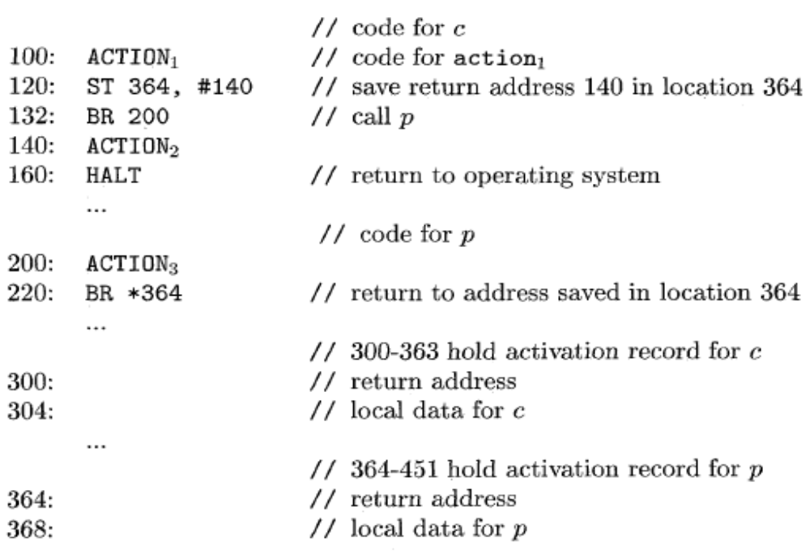
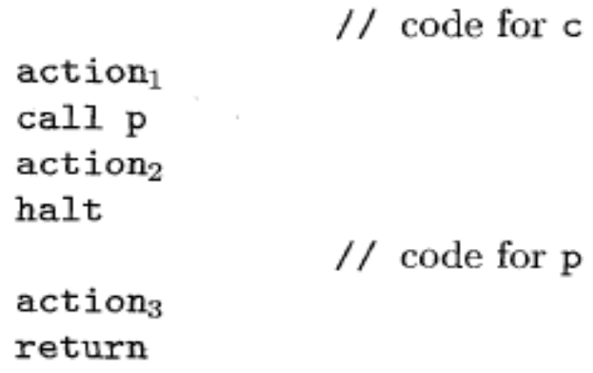
Target program for a sample call and return
Notes:
lec07-intermediatecg
January 4, 1980

Slide 36
A Simple Code Generator
Input : A sequence of three address code
Ouput : Code
Method
For each three address statement of the form x = y op z
1. Invoke a function getreg to determine the location L where the result of the computation y op z should be stored.
2. Consult the address descriptor for y to determine y' , the current location of y. If the value of y is not already in L, generate the instruction MOV y', L.
3. Generate the instruction OP z', L. Update the address descriptor of x to indicate that x is in location L
4. If the current locations of y and z have no next use, alter the register descriptor.
Notes:
lec07-intermediatecg
January 4, 1980

Slide 37
This algorithm uses two descriptors to keep track of register contents and addresses for names.
Register descriptor: keeps track of what is currently in each register.
Address descriptor: keeps track of the location where the current value of the name can be found at run time. The location can be a register, a memory location or a stack location.
Notes:
lec07-intermediatecg
January 4, 1980

Slide 38
Statement | Code Generated | Register descriptor | Address Descriptor
 |  | Registers empty
t = a - b | MOV a,R0 SUB b,R0 | R0 contains t | t in R0
u = a- c | MOV a,R1 SUB b,R0 | R0 contains t R1 contains u | t in R0 u in R1
Notes:
lec07-intermediatecg
January 4, 1980

